Slide 1
HTML vs XHTML

Slide 2
XHTML 1.0 was created shortly after HTML 4.01 to help the transition of hypertext to a new generation of mark-up languages for text.
XHTML 1.1 is an additional step toward a more flexible version of hypertext with the full benefits of XML architecture and integration of different technologies.
Note that XHTML 1.1 has slightly improved the semantics of HTML 4.01 by including the Ruby module, used in particular languages like Japanese scripts.

Slide 3
What Is XHTML?
XHTML stands for EXtensible HyperText Markup Language
XHTML is almost identical to HTML
XHTML is stricter than HTML
XHTML is HTML defined as an XML application
XHTML is supported by all major browsers

Slide 4
Why XHTML?
Many pages on the internet contain "bad" HTML.
This HTML code works fine in most browsers (even if it does not follow the HTML rules):
<html>
<head>
<title>This is bad HTML</title>
<body>
<h1>Bad HTML
<p>This is a paragraph
</body>

Slide 5
Today's market consists of different browser technologies.
Some browsers run on computers, and some browsers run on mobile phones or other small devices.
XML is a markup language where documents must be marked up correctly (be "well-formed").
By combining the strengths of HTML and XML, XHTML was developed.
XHTML is HTML redesigned as XML.

Slide 6
The Most Important Differences from HTML:
Document Structure
XHTML Elements
XHTML Attributes

Slide 7
Document Structure
XHTML DOCTYPE is mandatory
The xmlns attribute in <html> is mandatory
<html>, <head>, <title>, and <body> are mandatory

Slide 8
XHTML Elements
XHTML elements must be properly nested
XHTML elements must always be closed
XHTML elements must be in lowercase
XHTML documents must have one root element.

Slide 9
XHTML Attributes
Attribute names must be in lower case
Attribute values must be quoted
Attribute minimization is forbidden

Slide 10
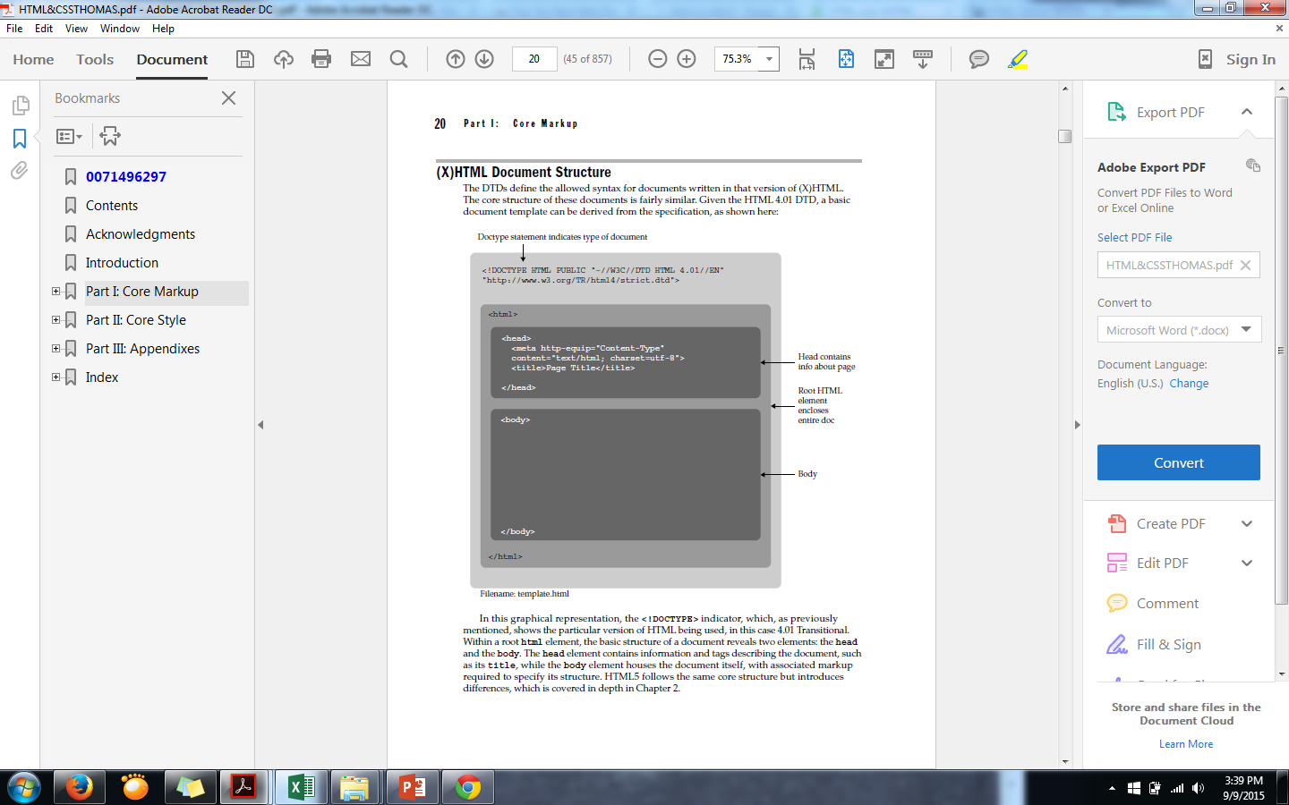
HTML doc structure

Slide 11
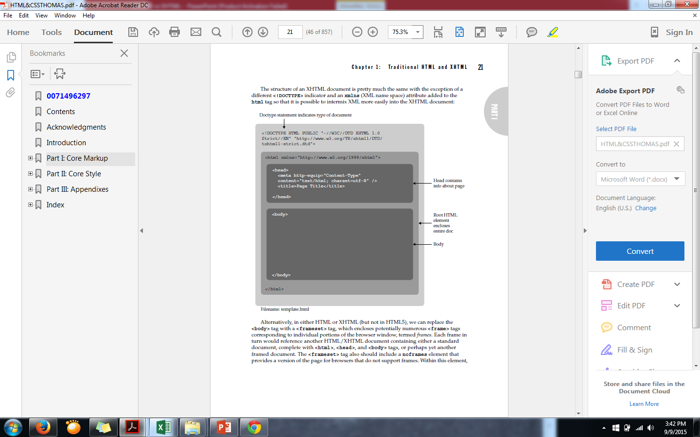
XHTML doc structure

Slide 12
<!DOCTYPE ....> Is Mandatory
An XHTML document must have an XHTML DOCTYPE declaration.
The <html>, <head>, <title>, and <body> elements must also be present, and the xmlns attribute in <html> must specify the xml namespace for the document.
This example shows an XHTML document with a minimum of required tags:

Slide 13
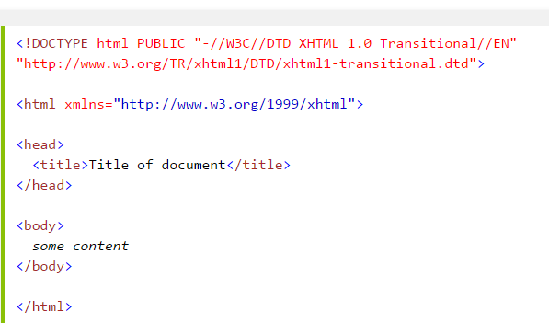

Slide 14
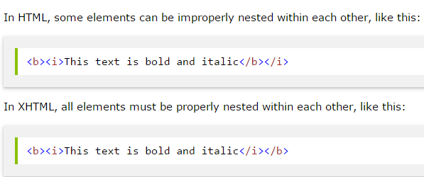
XHTML Elements Must Be Properly Nested

Slide 15
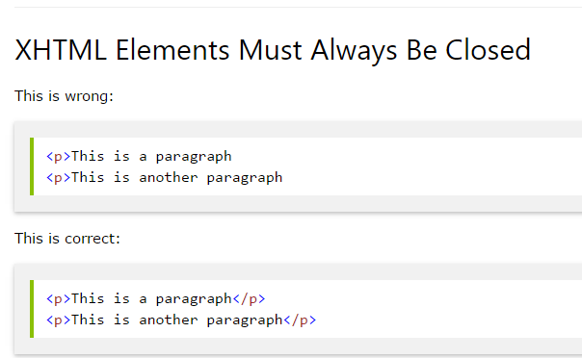

Slide 16
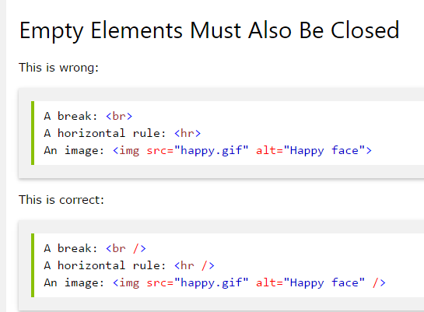

Slide 17
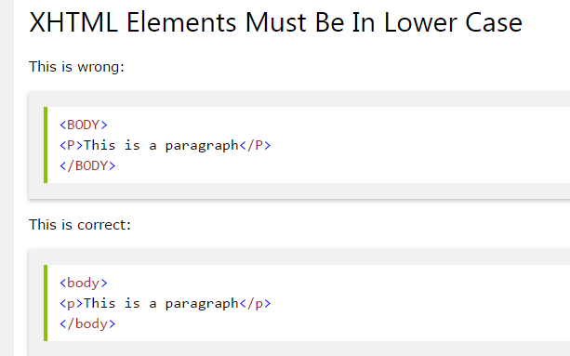

Slide 18
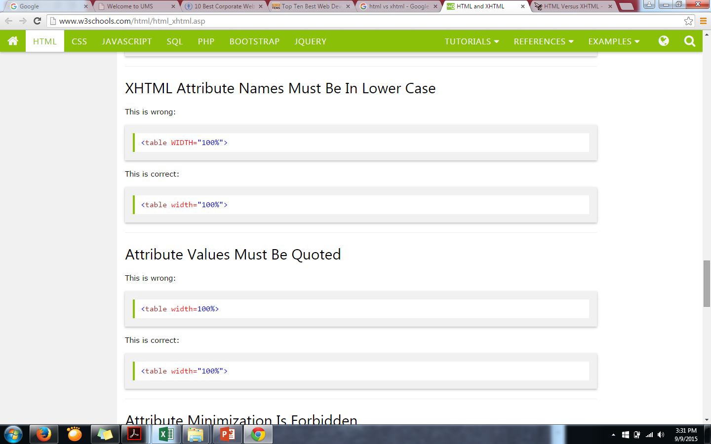

Slide 20
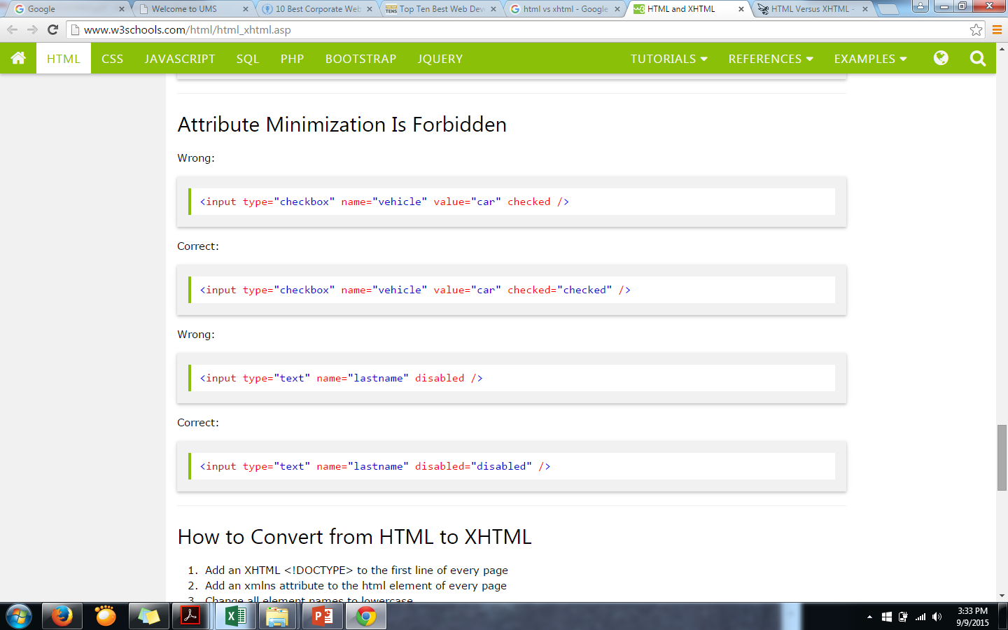

Slide 21
